Slide 1

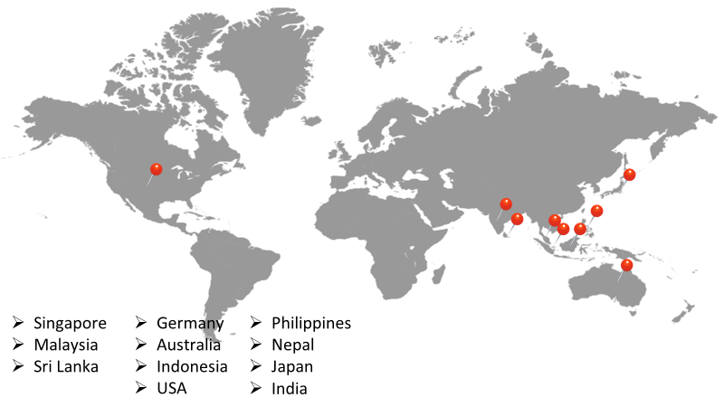
ABOUT ACCURACY
Accuracy is a Singapore Data & AI Company primarily focused on data Consulting, Product development, Services, and resourcing.
Partnerships with 20+ Data & AI product companies, 15+ domain experts and 10+ data providers, across the globe.
Serving across industrial verticals

Slide 2

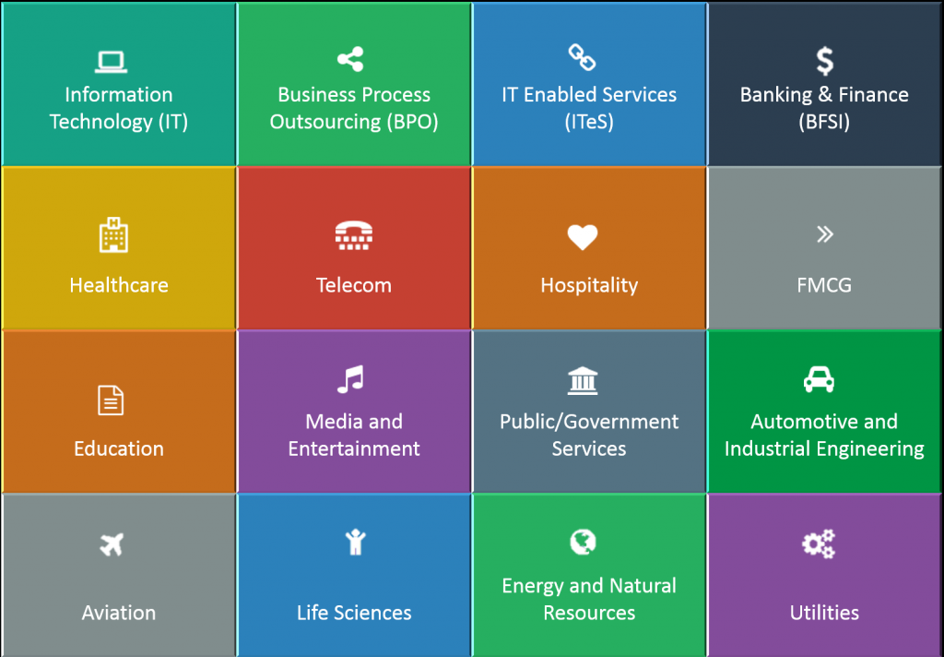



DATA & AI SERVICES
1
2
3
4
Consulting
Products
Services
Resourcing
15+ Domain Experts
20+ Data Products
100+ Data Services
30+ Technologies
Notes:
At A Glance
Accuracy products addresses Analytics in various areas without deviating Customers from current Data warehousing, BI solutions investment with a seamless API integration with the value of Analytics, AI embedded into any existing applications.
Accuracy is progressing ahead of emerging trends like AI, Mobility, IoT, Big Data and Cloud in its specialization.
Three Main Sections of Accuracy Products and Services:
Data and AI Products – these are products that Accuracy re-sells from our partner data and AI product providers,
Data and AI Services such as Data Consulting, Database Migrations, DWH/MDM/BI, Advanced Analytics, Big Data and Artificial Intelligence,
Resource Augmentation – Accuracy provides you the experts for over 40 data technologies, Data and AI Resources, APJ Coverage and Flexible T & M Models

Slide 3
JOB STREET PROBLEM STATEMENT
Jobstreet is the preferred online job portal by both candidates and companies seeking to fill vacancies. One of the concerns of Jobstreet management is how to better serve their clients both internal and external, and one of the things that they are currently looking at is accounts matching.
The priority at the moment is to match :
how to identify unique and duplicate job posting
How to eliminate multiple job posting
How to qualify job postings as unique or duplicate when recruiter indicated a different designation or title

Slide 4
SOLUTION
To solve the above problems Accuracy team found a solution using matching algorithm
Using SQL functions we got Unique and Duplicate records from the original dataset.
To eliminate the multiple job postings we used String functions in SQL
We applied the matching logic on designation/title/Job ad to identify the job postings as unique or duplicate.

Slide 5
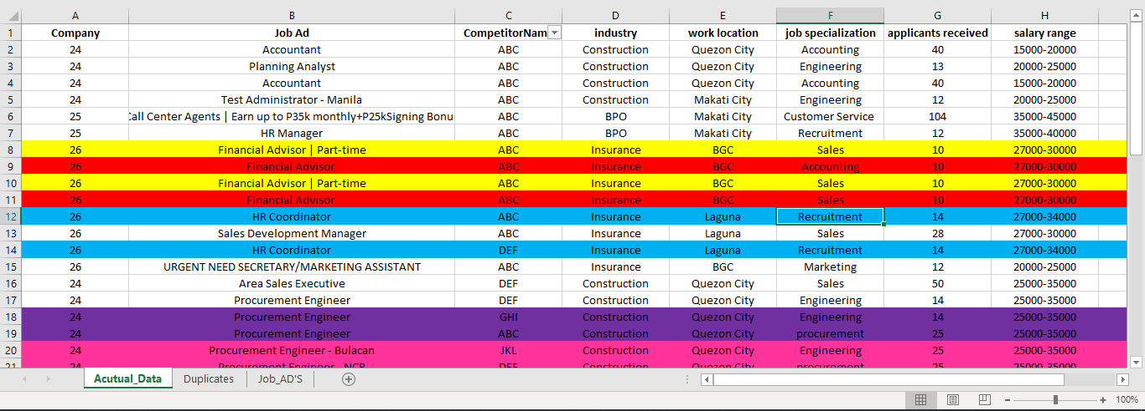
SOURCE DATA
The Business Analytics Group of Jobstreet has provided Accuracy a sample data, and the team has included a few more information to make the data useful. SOURCE1

Slide 6
SOURCE DATA
Highlighted in YELLOW. This is a case of exactly the same job ad from the same company client posted in the same Job portal
Highlighted in RED. This is a case of exactly the same job ad posted in the same job portal but with different Job Specialization. In this case, we can tag as “for further investigation”, subject for Jobstreet’s management discretion. Depending on how they treat the case.
Highlighted in BLUE. This is a case of exactly the same job ad posted in 2 different job portals. (means it is one company client posting in 2 job portals. Example Jobstreet and Monster)
Highlighted in light GREEN. This is a case of exactly the same job ad, but in the job ad itself the recruiter from the same company client included a location and posted in the same job portal.
In the example, this may be a duplicate since Makati City is part of NCR (National Capital Region)
Highlighted in Violet. This is a case of exactly the same job ad posted by the same company client in 2 different job portals with 2 different job specialization.
Highlighted in Pink. This is a case of exactly the same job ad posted by the same company client, but the recruiter indicated 2 different locations and 2 different job specialization.

Slide 7
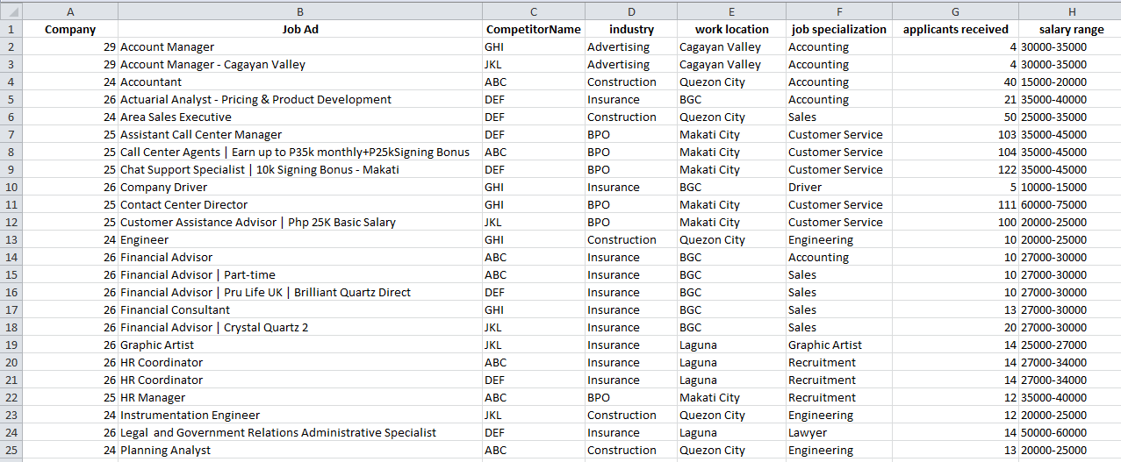
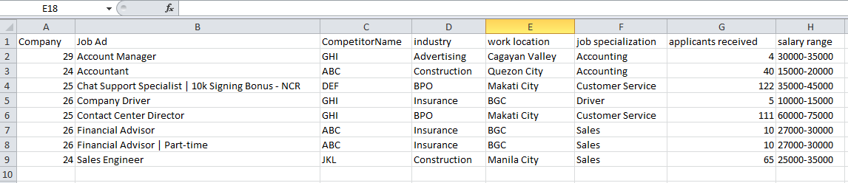
RESULTS
Unique Results:
Duplicate Results
Unique Results
Duplicate Results:

Slide 8


